Slide 1

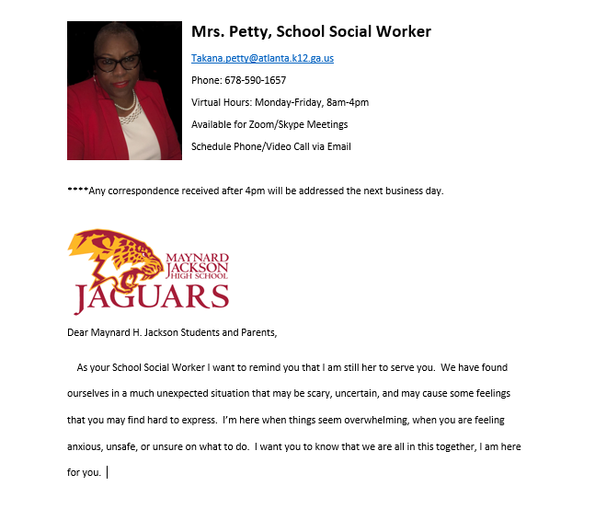













Maynard Jackson H.S.
Welcome to Ms. Pettys’ Office
Office: 404-802-5232
Cell: 678-590-1657
Email: takana.petty@atlanta.k12.ga.us
Resources Contact me here
Nutrition

